Slide 1
CSC589 Introduction to Computer Vision Lecture 9
Sampling, Gaussian Pyramid
Bei Xiao

Slide 2
What we have learned so far
Image contrast, histograms, and basic manipulation
Image Convolution
Image Filters
Fourier transform
Filtering in Fourier transform

Slide 3
What we want to achieve in this course?
Basic image processing (extract contours, boundaries, edges).
Basic understanding of image formation (camera models, projection)
Basic skills of image synthesizing (textures, panorama images, image hybrid, stereo)
Basic understanding of image features (HOG, SIFT, optical flow).
Basic exposure of the state of the art computer vision applications. (multiple object tracking, segmentation, 3D construction, recognition of objects and faces)
Application of machine learning in CV (Clustering, Bayesian, deep learning intro).
Basic mathematical concepts behind image processing (Fourier transform, convolution, probability and statistics ).
Brushing up numerical Python skills
If you have made progress in at least 4 out of the above points, it is a success!

Slide 4
Exercise 1
Download the FFTAnalysis.py from blackboard.
Use the einstein.png
Right now the image removes low frequency (center) of the images.
Can you modify the code that you are removing the high frequency (low pass) the image? You can do this either by directly modifying the DFT or use a filter.

Slide 5
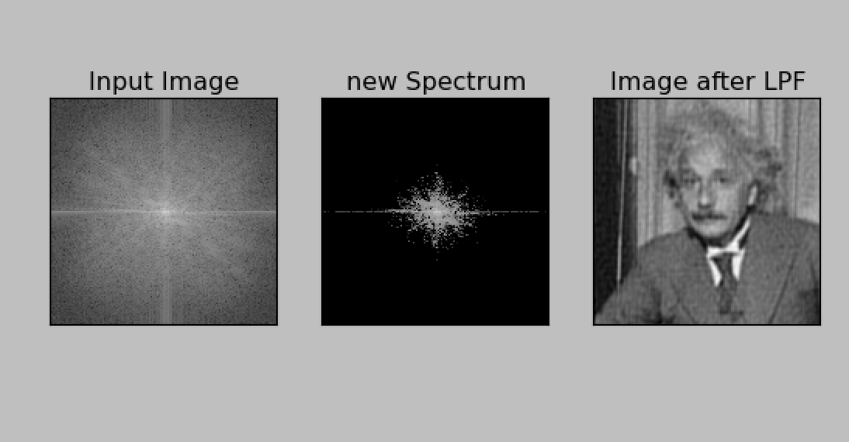
Exercise 1
mask = abs(fshift) < 10000
fshift[mask]= 10

Slide 6
Exercise 2
Download the Cheetha and Zebra images
DFT both images in Fourier domain and compute magnitude and phase. I have already did this in the helper code PhaseandMagnitude.py
You can compute phase and magnitude as this:
magnitude_zebra = 30*np.log(np.abs(fshift))
phase_zebra = np.angle(fshift)
Reconstruct the image with Cheetha phase and Zebra magnitude and vice versa. You have to do this yourself!

Slide 7
Inverse Fourier Transform
Forward Fourier:
img = misc.imread('cheetah.png',flatten=1)
f = np.fft.fft2(img)
fshift = np.fft.fftshift(f)
magnitude_cheetah = np.abs(fshift)
phase_cheetah = np.angle(fshift)
Inverse Fourier:
re = magnitude_zebra*np.cos(phase_zebra)
im = magnitude_zebra*np.sin(phase_zebra)
F = re+1j*im
f_ishift = np.fft.ifftshift(F)
img_back = np.fft.ifft2(f_ishift)
img_back = np.abs(img_back)
#img_back= misc.bytescale(img_back)
print img_back.min(), img_back.max()
plt.imshow(np.uint8(img_back), cmap='gray')

Slide 8
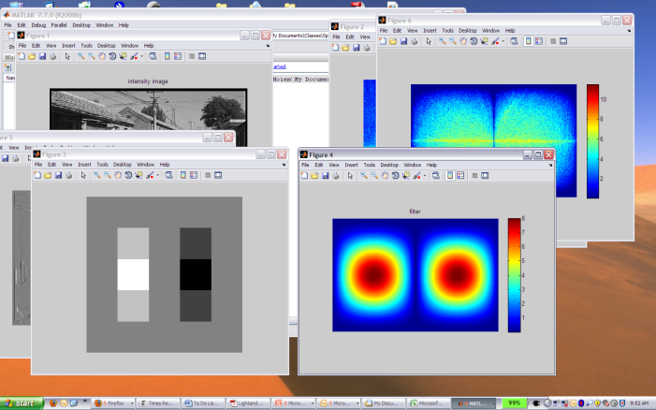
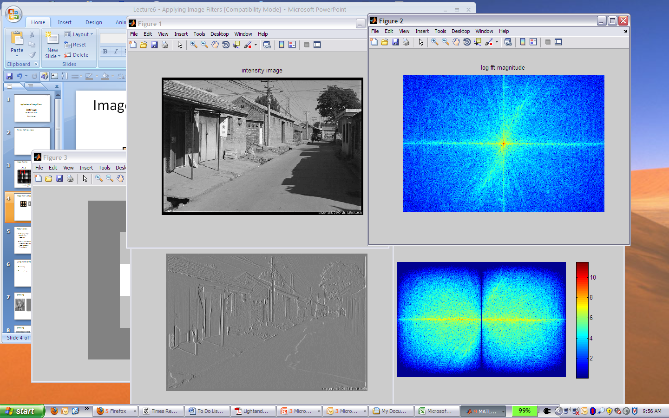

Filtering in frequency domain
FFT
FFT
=
Inverse FFT
Slide: Hoiem

Slide 9
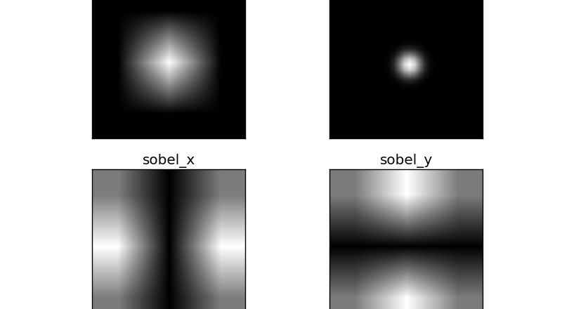
Filters in Fourier Domain
Mean filter
Gaussian Filter

Slide 10


Sampling
Why does a lower resolution image still make sense to us? What do we lose?
Image: http://www.flickr.com/photos/igorms/136916757/

Slide 11
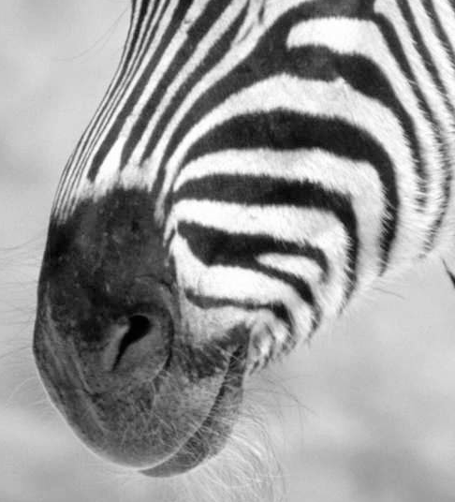
Subsampling by a factor of 2
Throw away every other row and column to create a 1/2 size image

Slide 12
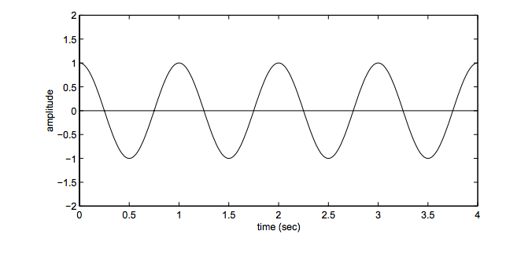
Aliasing problem
1D example (sinewave):
http://redwood.berkeley.edu/bruno/npb261/aliasing.pdf

Slide 13
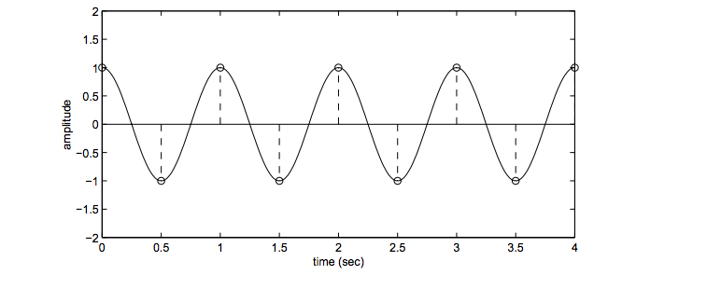
Aliasing problem
1D example (sinewave):
Sample at 2Hz
http://redwood.berkeley.edu/bruno/npb261/aliasing.pdf

Slide 14
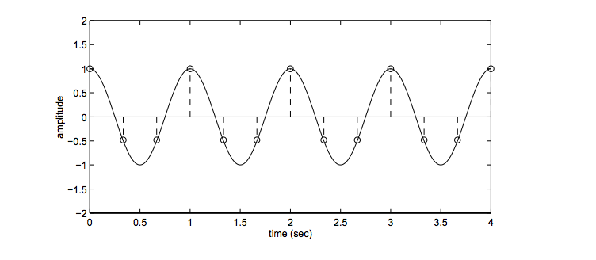
Aliasing problem
1D example (sinewave):
Sample at 3Hz
http://redwood.berkeley.edu/bruno/npb261/aliasing.pdf

Slide 15
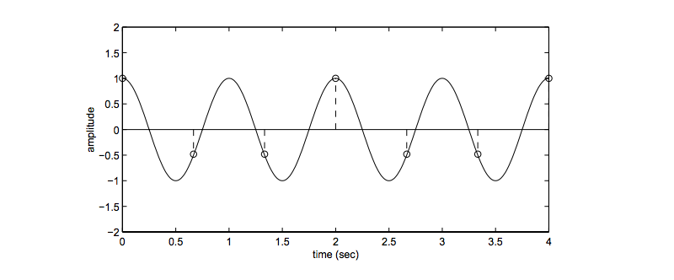
Aliasing problem
1D example (sinewave):
Sample at 1.5 Hz
http://redwood.berkeley.edu/bruno/npb261/aliasing.pdf

Slide 16
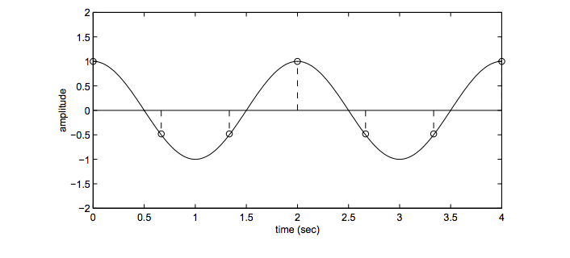
Aliasing problem
1D example (sinewave):
Sample at 1.5 Hz
http://redwood.berkeley.edu/bruno/npb261/aliasing.pdf

Slide 17
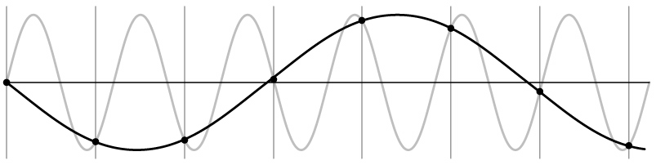
Aliasing problem
1D example (sinewave):
http://redwood.berkeley.edu/bruno/npb261/aliasing.pdf

Slide 18
Aliasing problem
Sub-sampling may be dangerous….
Characteristic errors may appear:
“Wagon wheels rolling the wrong way in movies”
“Checkerboards disintegrate in ray tracing”
“Striped shirts look funny on color television”
Source: D. Forsyth

Slide 19
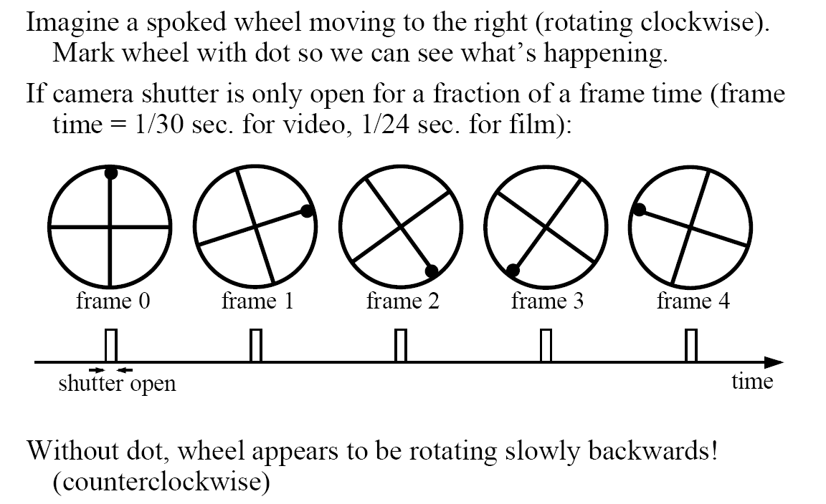
Aliasing in video
Visual illusion: http://www.michaelbach.de/ot/mot-wagonWheel/index.html
Slide by Steve Seitz

Slide 20
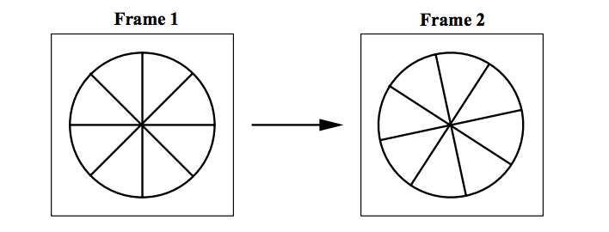
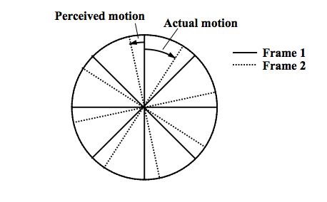
Aliasing in video
http://redwood.berkeley.edu/bruno/npb261/aliasing.pdf

Slide 21
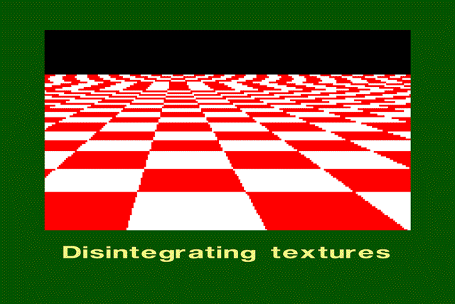
Aliasing in graphics
Source: A. Efros

Slide 22
Sampling and aliasing

Slide 23
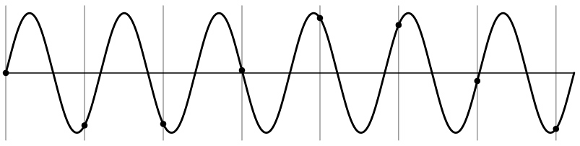
Nyquist-Shannon Sampling Theorem
When sampling a signal at discrete intervals, the sampling frequency must be ≥ 2 × f_{max}
f_{max} = max frequency of the input signal
This will allows to reconstruct the original perfectly from the sampled version
v
v
v
good
bad

Slide 24
Anti-aliasing
Solutions:
Sample more often
Get rid of all frequencies that are greater than half the new sampling frequency
Will lose information
But it’s better than aliasing
Apply a smoothing filter

Slide 25
Algorithm for downsampling by factor of 2
Start with image(h, w)
Apply low-pass filter
im_blur = ndimage. filters_ gaussian_filter (image, 7)
Sample every other pixel
im_small = im_blur[::2; ::2];

Slide 26
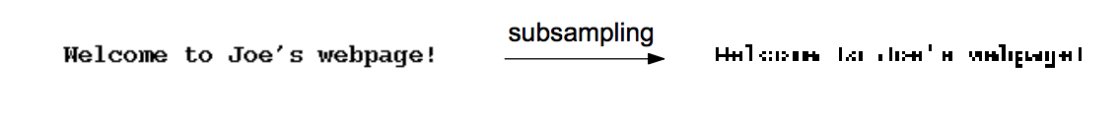
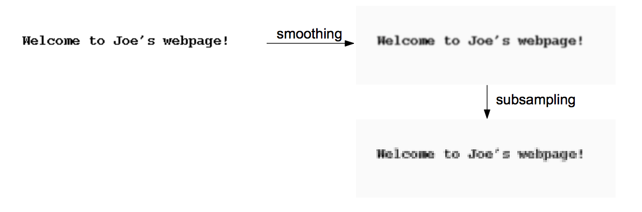
Text images

Slide 27
Anti-aliasing
Forsyth and Ponce 2002

Slide 28
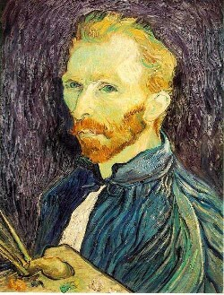
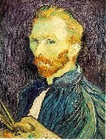

Subsampling without pre-filtering
1/2
1/4 (2x zoom)
1/8 (4x zoom)
Slide by Steve Seitz

Slide 29



Subsampling with Gaussian pre-filtering
Gaussian 1/2
G 1/4
G 1/8
Slide by Steve Seitz

Slide 30
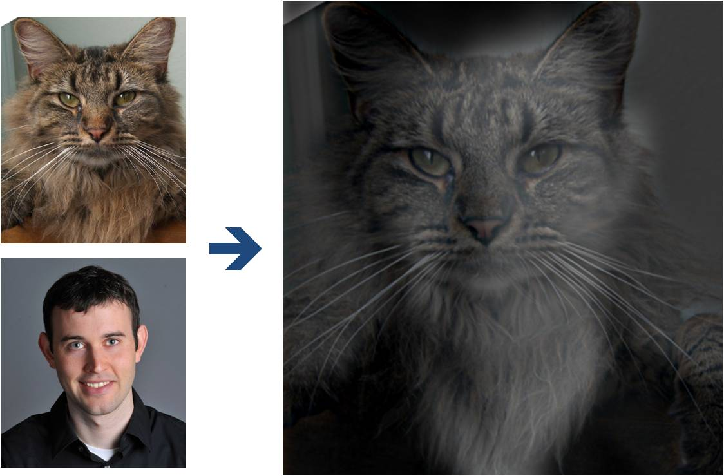
Why do we get different, distance-dependent interpretations of hybrid images?
?

Slide 31
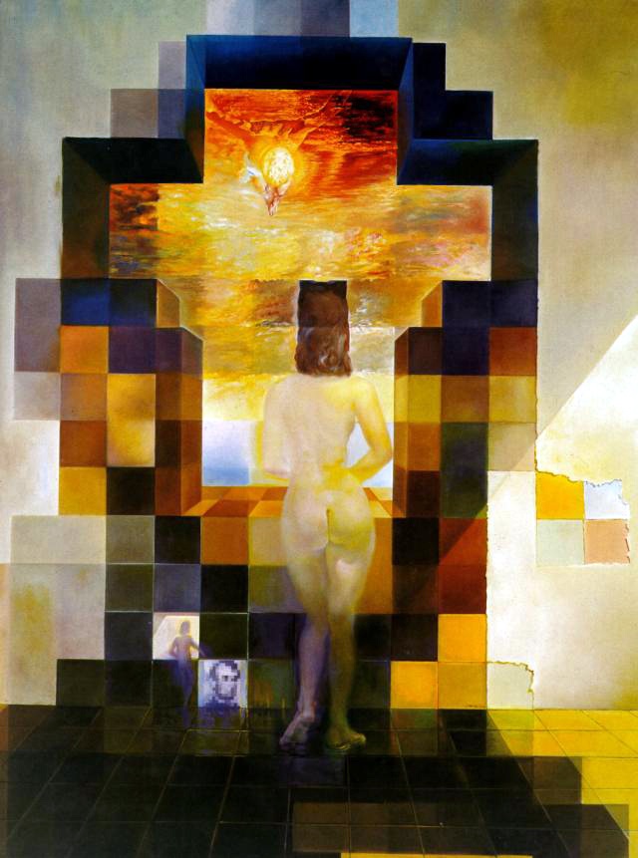
Salvador Dali invented Hybrid Images?
Salvador Dali
“Gala Contemplating the Mediterranean Sea,
which at 30 meters becomes the portrait
of Abraham Lincoln”, 1976

Slide 32
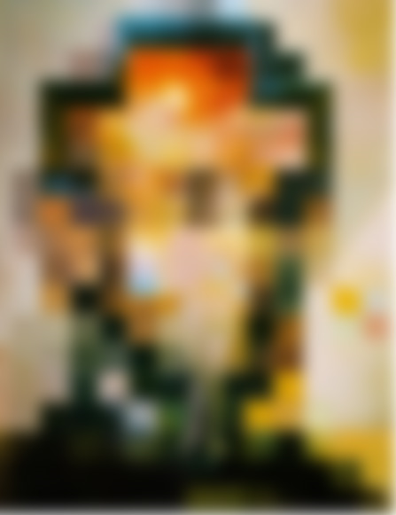

Slide 34
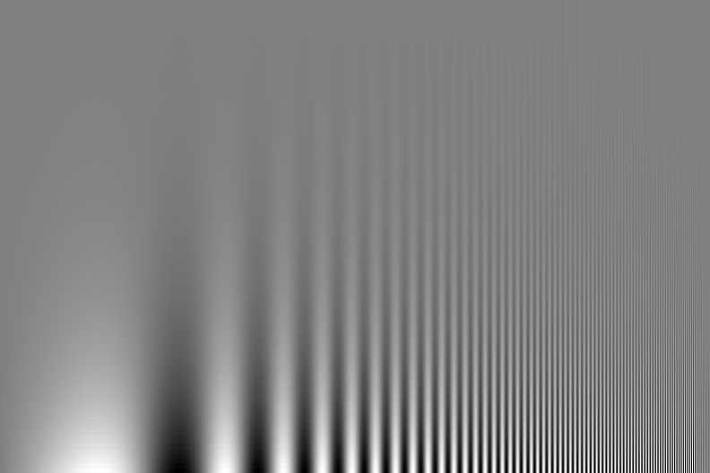
Campbell-Robson contrast sensitivity curve

Slide 35
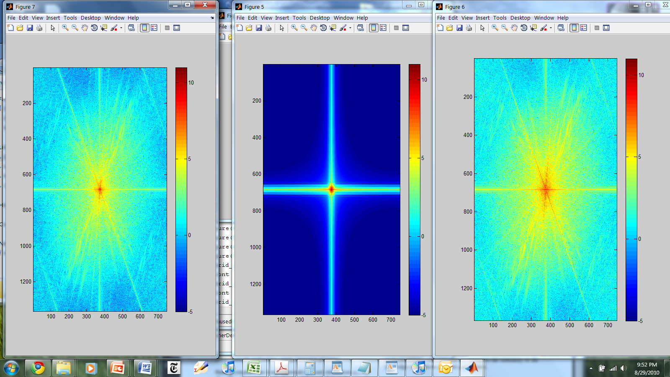
Hybrid Image in FFT
Hybrid Image
Low-passed Image
High-passed Image

Slide 36
Perception
Why do we get different, distance-dependent interpretations of hybrid images?
?

Slide 37
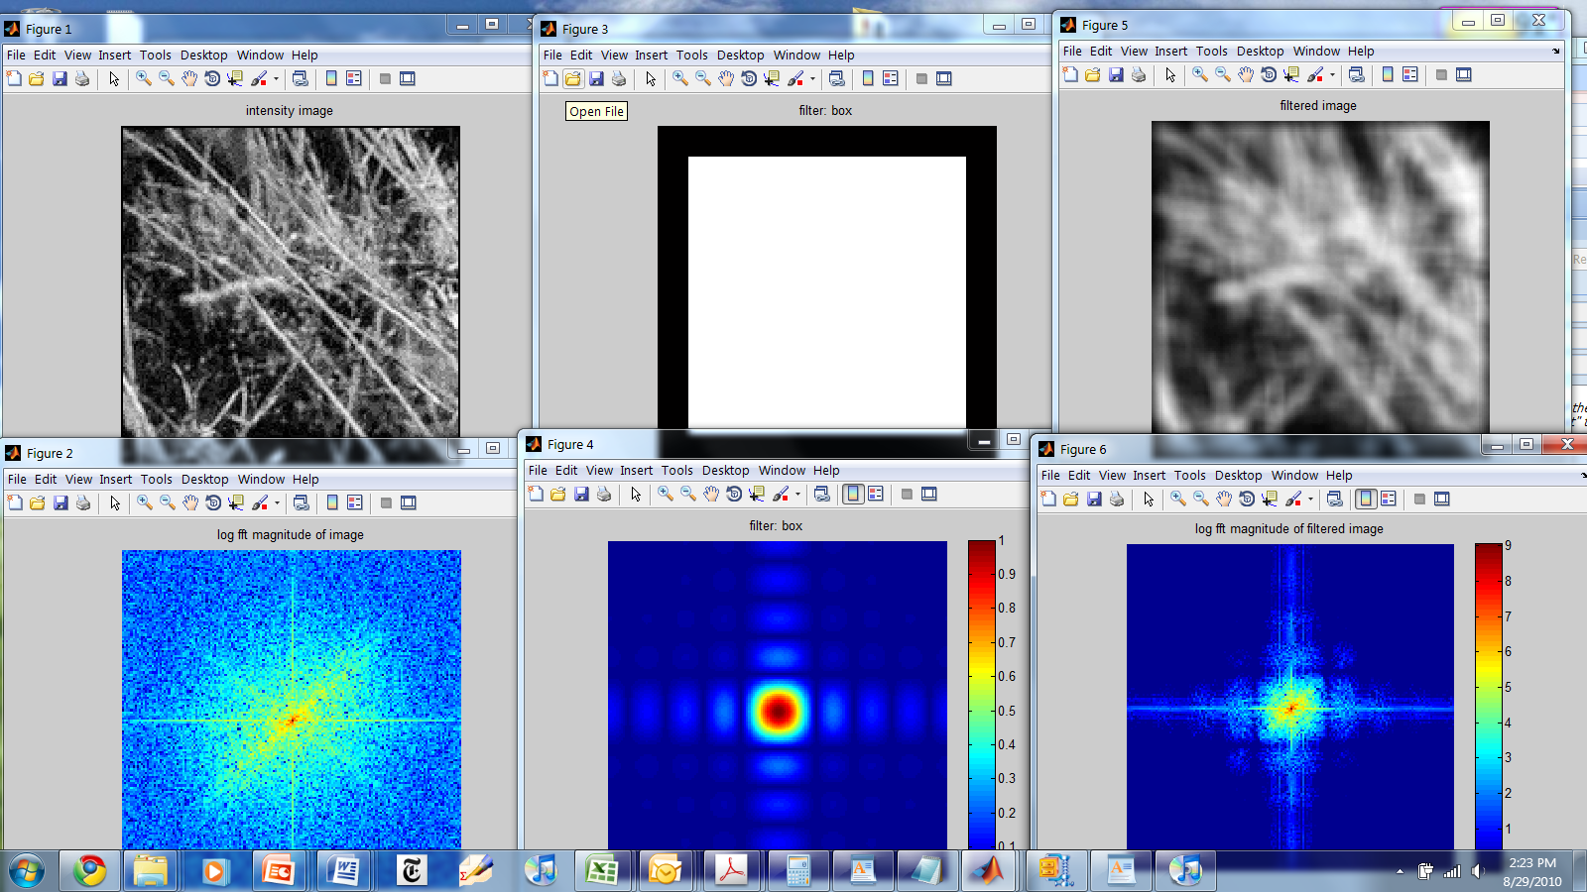
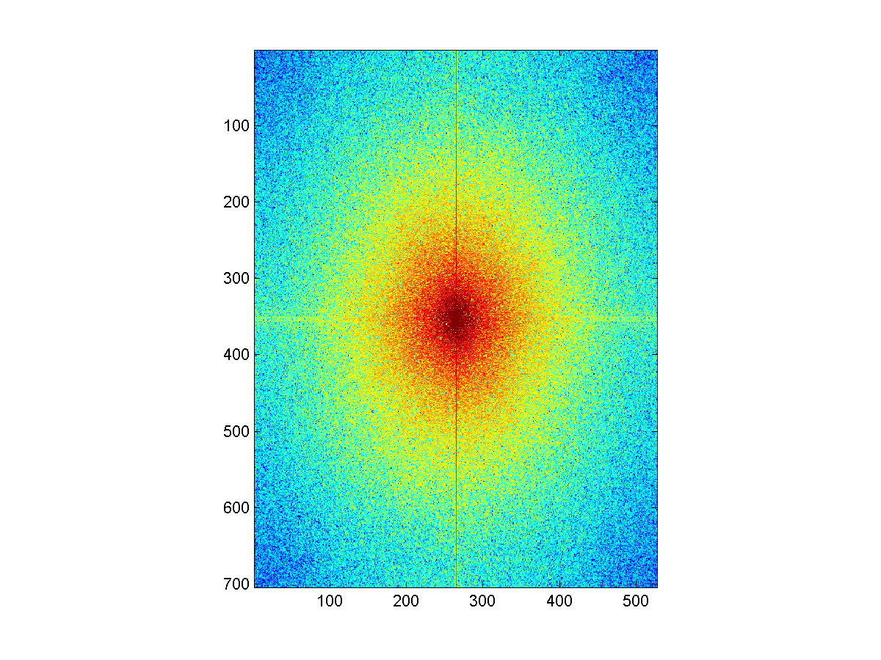
Things to Remember
Sometimes it makes sense to think of images and filtering in the frequency domain
Fourier analysis
Can be faster to filter using FFT for large images (N logN vs. N² for auto-correlation)
Images are mostly smooth
Basis for compression
Remember to low-pass before sampling

Slide 38
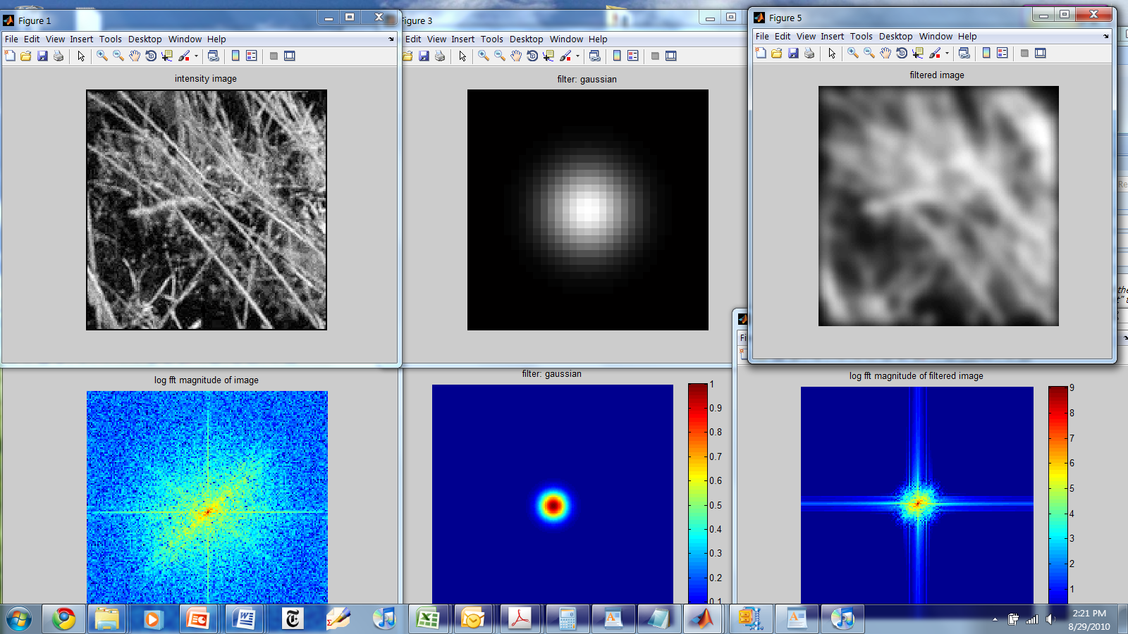
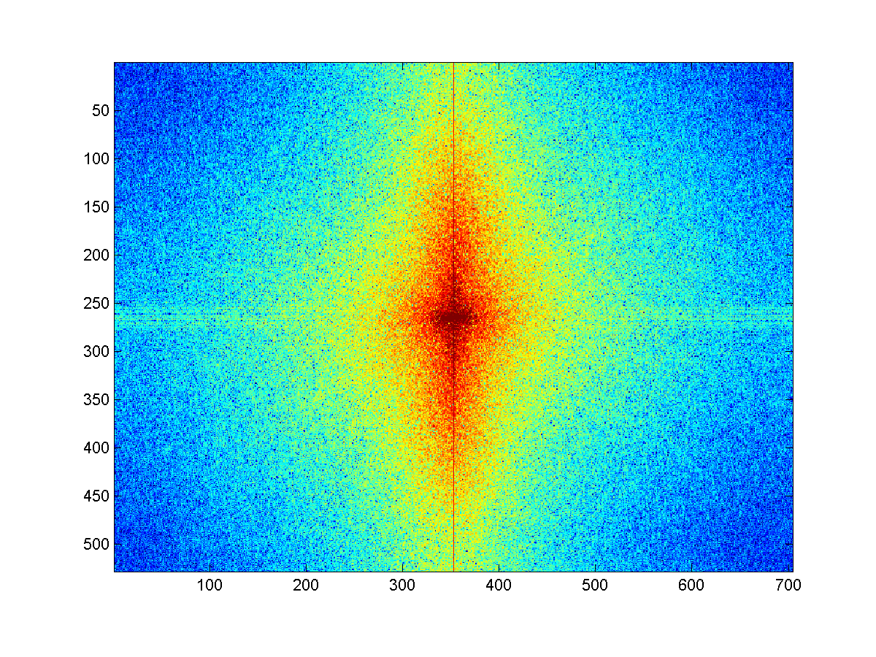
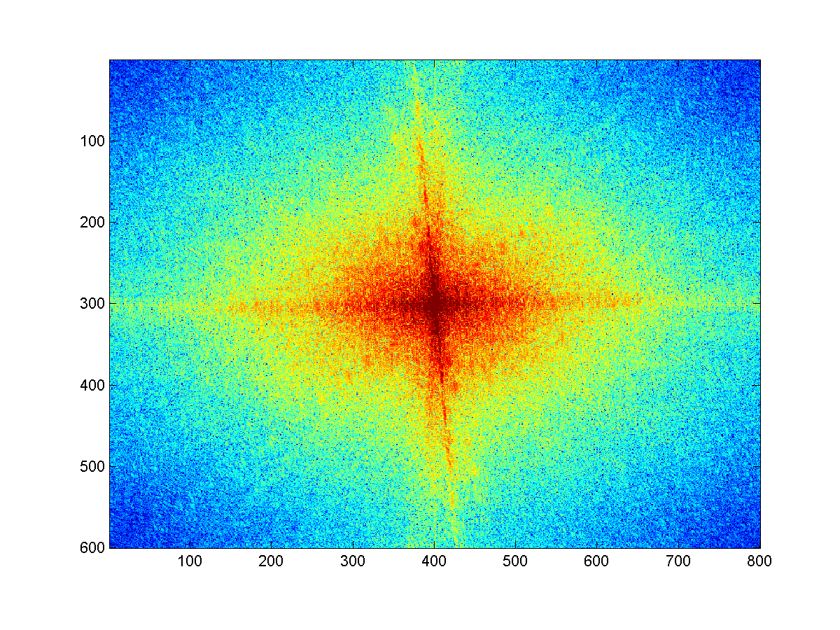
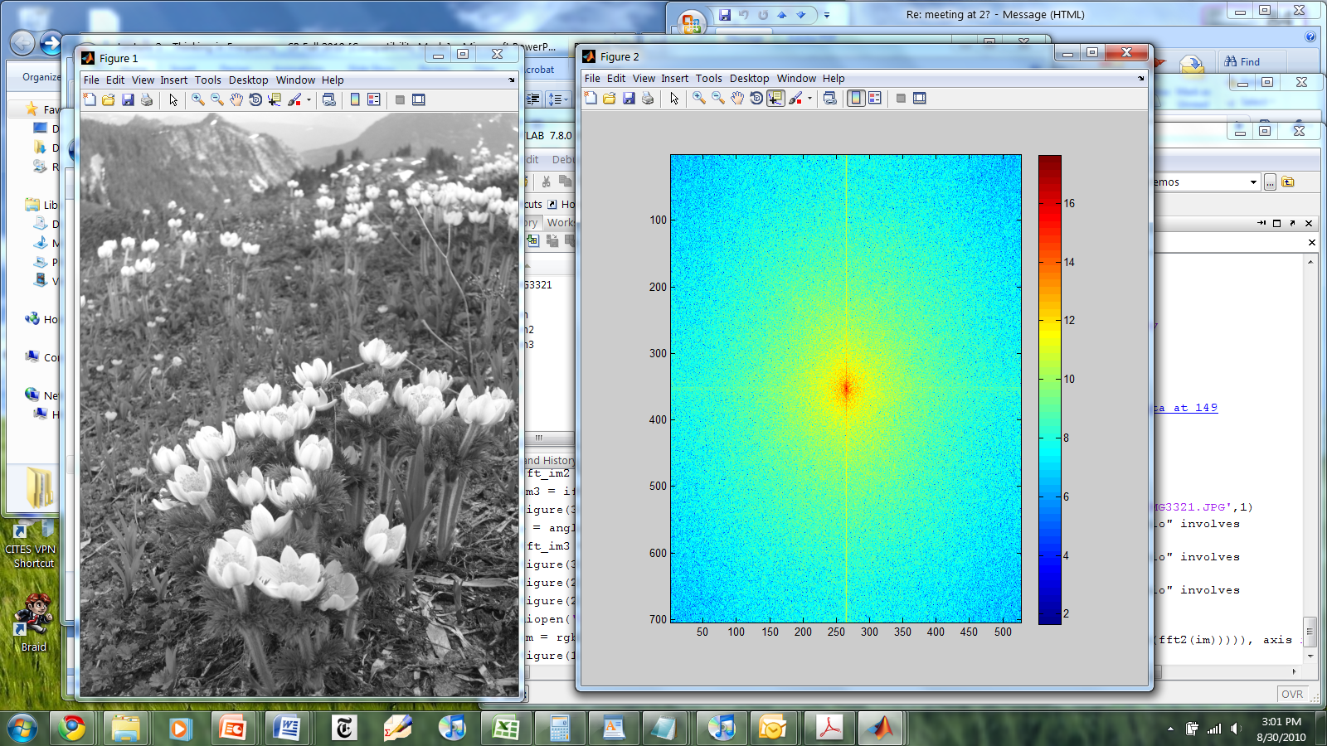
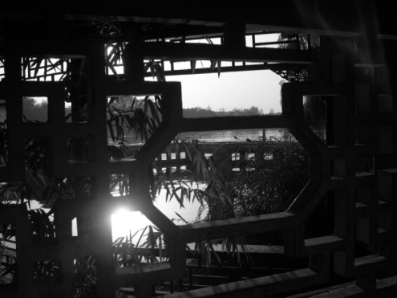
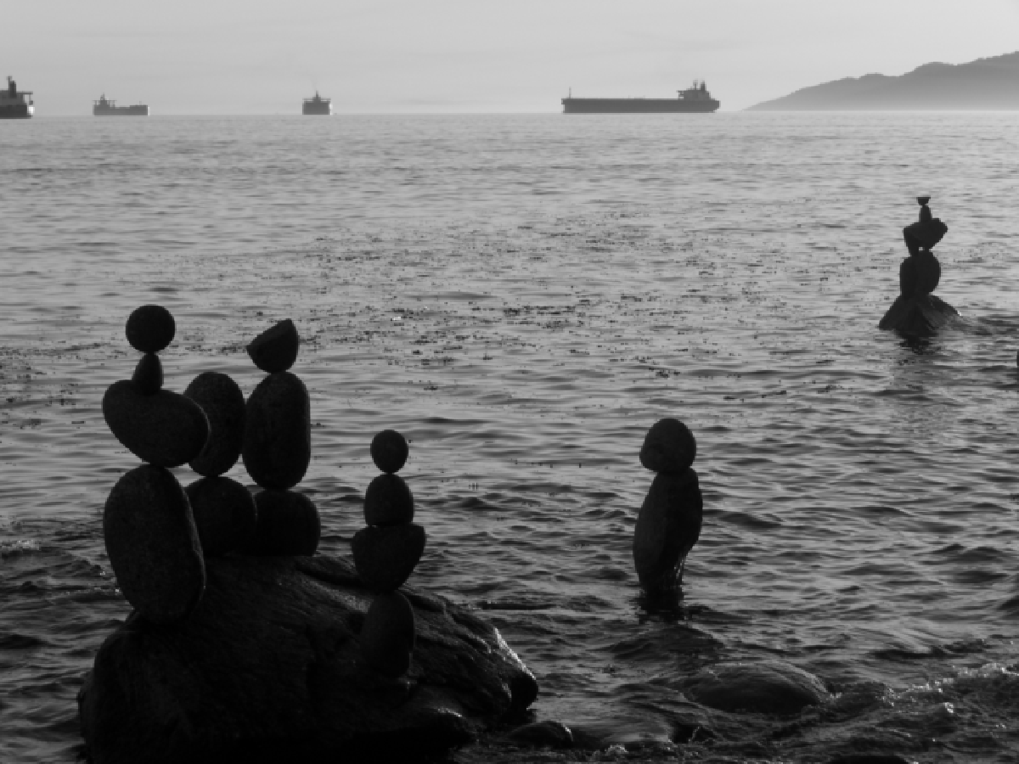

Practice question
Match the spatial domain image to the Fourier magnitude image
1
2
3
4
5
B
A
C
E
D
Notes:
1: D
2. B
3. A
4. C
5. E

Slide 39
Take home reading
Aliasinghttp://redwood.berkeley.edu/bruno/npb261/aliasing.pdf
Fourier Transform: Chapter 3.4
Next class: Template Matching, Gaussian Pyramid, Filter banks and Texture

